Slide 1
Lecture 07 Visual analytics of spatio-temporal data
Module INM433 – Visual Analytics
given by
prof. Gennady Andrienko and
prof. Natalia Andrienko

Slide 2
Previous lectures
Subject of analysis as a system of components linked by relationships
Understanding relationships through exploring distributions and seeking patterns
Kinds of possible patterns depending on types of components
Particularly, patterns in temporal and spatial distributions
Use of partition-based and density-based clustering for exploring distributions
Distance functions
Patterns revealed by PBC and DBC:
Groups of similar objects and their representative profiles (PBC)
Densely and sparsely filled regions; frequently occurring conjunctions of object characteristics (DBC)

Slide 3
This lecture
Types of phenomena and data that have spatial and temporal components: spatial events, spatial time series, and trajectories of moving objects
Transformations from one data type to another
Spatio-temporal aggregation
Event extraction
Two perspectives of spatial time series:
Spatial distribution of local temporal variations
Temporal variation of spatial distributions
Use of clustering in exploration of spatio-temporal data
In particular, two-way partition-based clustering of spatial time series

Slide 4
Analysis subject and goal
Subject (of analysis)
Component
a reminder from lecture 3
Relationships
A subject of analysis can be considered as a complex system composed of multiple components linked by relationships.
The general goal of analysis is to study and model some of the relationships existing between the components of the subject.
Most common types of components:
Sets of discrete entities, a.k.a. objects (e.g., people, tweets)
Space (= set of locations)
Time (= set of moments)
Attribute values (e.g., numeric or categorical)
Component
…
Component

Slide 5
Types of discrete entities (objects)
a reminder from lecture 2
Generic objects
Spatial objects: have locations in space (points, lines, areas, volumes)
Temporal objects (events): appear and disappear
Spatio-temporal objects
Spatial events
events having spatial locations: earthquakes, traffic jams, geolocated tweet postings, …
Moving objects
change their location over time: people, animals, vehicles, storms, oil spills, …
Trajectories
lines (paths) in space and time; points and segments have attributes: speed, direction, …

Slide 6
Types of discrete objects
Objects
Spatial objects
Events
Spatial events
Moving objects
Trajectories
Moving events

Slide 7


Spatio-temporal data
Have both spatial and temporal components
The spatial and temporal components may play different semantic roles: references or attributes.
Reference: What is described?
Characteristic: What is known about it?
A reminder from lecture 2:
referents
Name | Birth date | School grade | Address | Distance to school, m | Getting to school
Peter | 17/05/2005 | 3 | 12, Pine street | 850 | by bus
Julia | 23/08/2004 | 4 | 9, Oak avenue | 400 | on foot
Paul | 10/12/2005 | 2 | 56, Maple road | 1500 | by car
Mary | 06/10/2003 | 5 | 71, Linden lane | 900 | on foot
references
characteristics (attribute values)
Referential component (referrer)
Characteristic components (attributes)

Slide 8
Types of spatio-temporal data
According to the semantic roles of space and time
Spatial time series:
attribute values refer to different spatial locations or static spatial objects and different times; space and time are references
Spatial event data: data characterising spatial events (i.e., discrete objects)
attribute values, including spatial location and existence time, refer to objects; space and time are attributes
Movement data (trajectories): data characterising moving objects (a specific kind of discrete spatial objects)
Space (spatial location) is an attribute of moving objects
The spatial location may change over time ⇒ the data include two or more spatial locations referring to different times ⇒ time is a reference

Slide 9
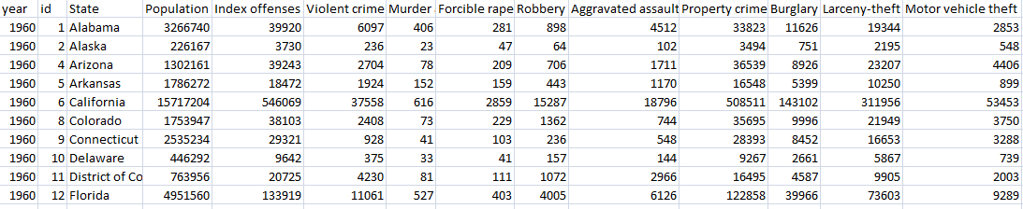
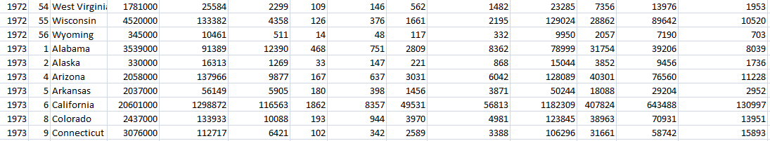
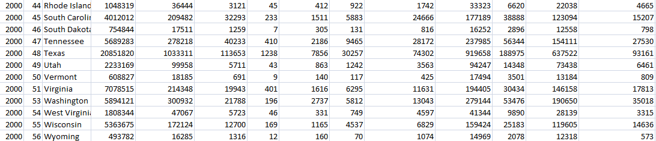
An example of spatial time series
Referrer 1: time
Referrer 2: place
Attributes
...
...

Slide 10
An example of spatial event data
Referrer: objects
time (attribute)
spatial location (attribute)

Slide 11
Visual displays of spatial events
Map: shows the spatial distribution
Space-time cube: shows the spatio-temporal distribution
Temporal display (e.g., frequency histogram of the occurrence times): shows the temporal distribution

Slide 12
Temporal distribution of events
A frequency histogram of the event occurrence times shows the overall temporal distribution of the events and exhibits temporal patterns such as temporal trends and periodicity. A periodic temporal distribution can be additionally explored using a 2D histogram, e.g., with the dimensions corresponding to the days of the week and hours of the day.

Slide 13
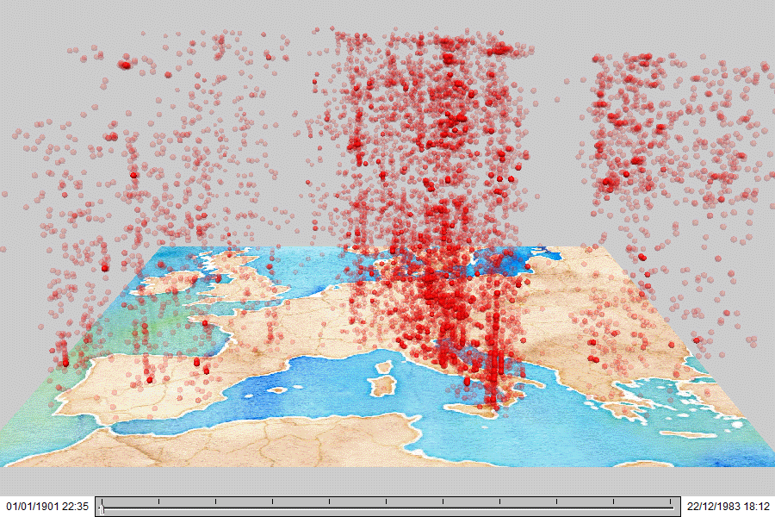
Space-time cube
Represents 2D space + time as a single 3D continuum, in which spatio-temporal objects, such as spatial events and trajectories, are positioned.
time
Hägerstrand. T. (1970). “What about people in regional science?” Papers of the Regional Science Association; 24:7-21.
Data: earthquake events in Europe 1901-1983

Slide 14
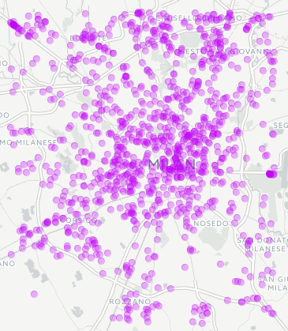
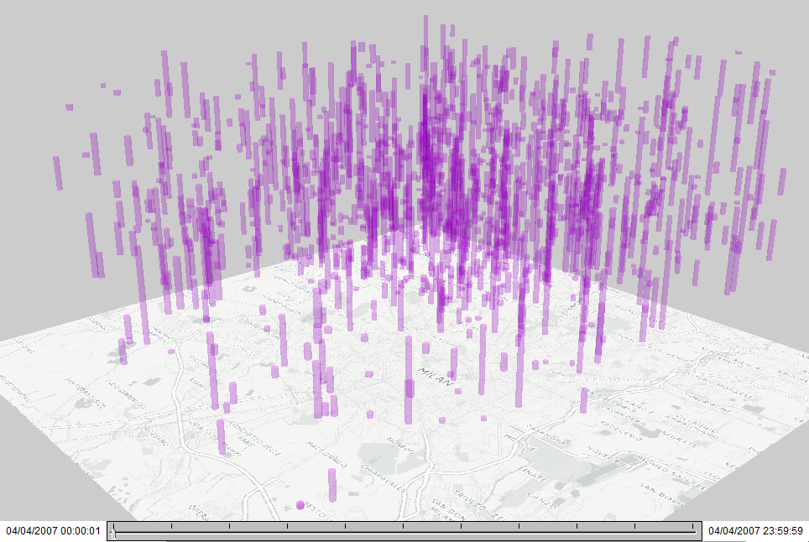
Representation of temporally extended (durable) events
Car stop events are represented by vertical bars in a space-time cube. The bar heights are proportional to the stop durations.

Slide 15
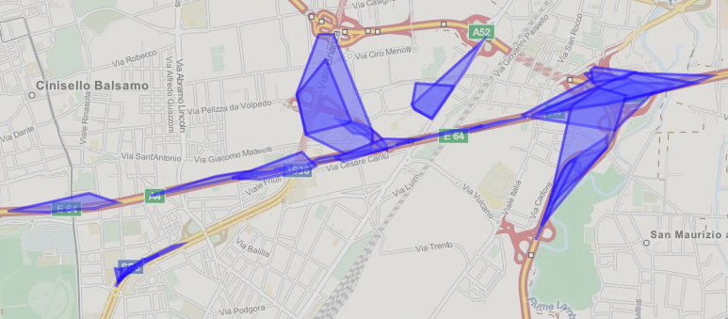
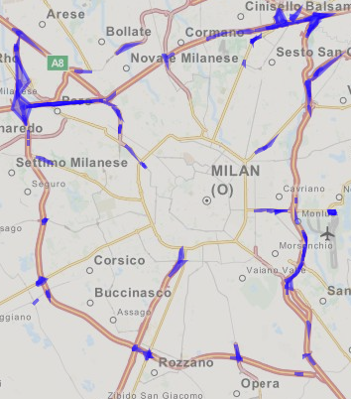
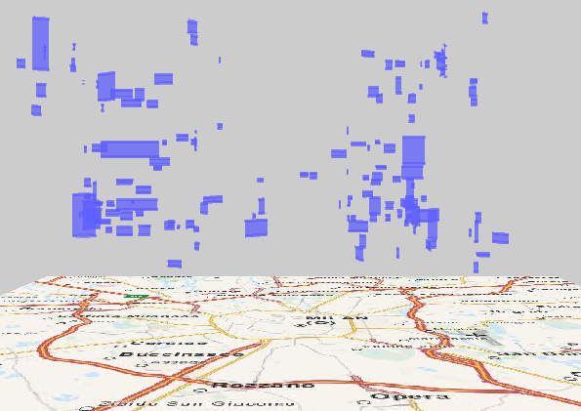
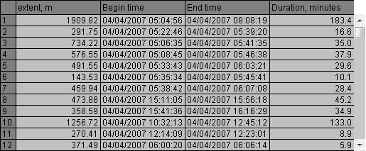
Representation of spatially and temporally extended events
time
Space-time cube

Slide 16
An example of movement data (trajectories)
Referrer 1: objects
Referrer 2: time
…
…
spatial location (attribute)

Slide 17
Structure of trajectory data
A trajectory of a moving object is represented by a sequence of position records: (time, location, <thematic attributes>)
The records specify where the object was at different time moments.
When a dataset contains trajectories of diverse moving objects, the position records must also contain object identifiers:
(object identifier, time, location, <thematic attributes>)
Trajectories are object-referenced time series of spatial locations
Besides, a trajectory by itself is a spatio-temporal object.
Spatial position: the path (line in space).
Existence time: the interval from the first to the last location.
A trajectory can be viewed as a line in the space-time continuum.

Slide 18
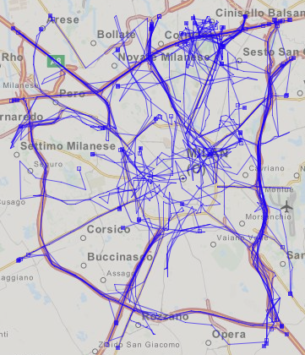
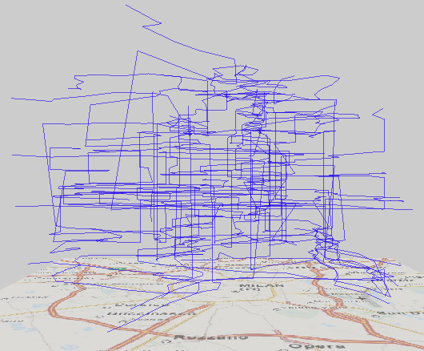
Visual representation of trajectories
time
Space-time cube

Slide 19
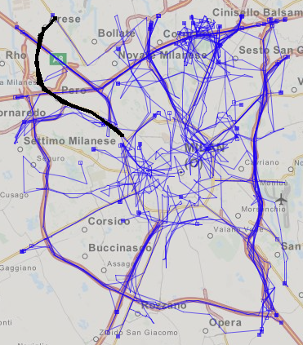
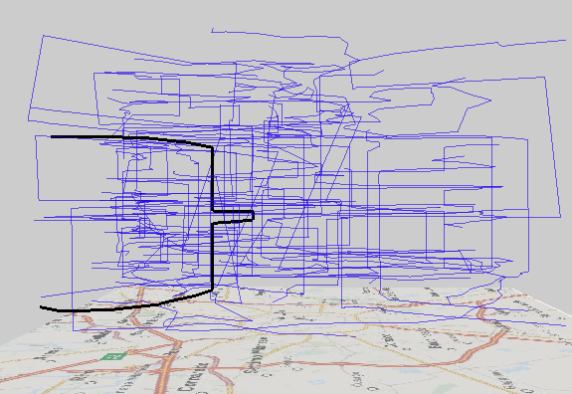
Spatio-temporal view
spatial footprint
movement B→A
movement C→B
A
end: place A
long stop: place B
B
C
short stop: place C
long stop: place B
start: place A
time
North
movement A→B
movement B→C
South

Slide 20
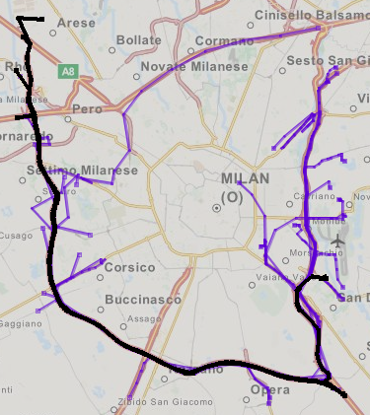
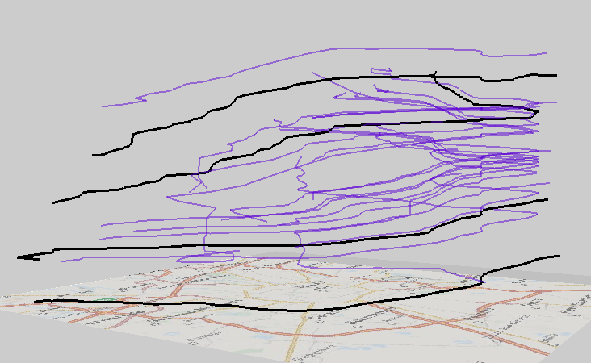
Spatio-temporal view
time
slow movement
fast movement
Northeast
Southwest

Slide 21
Spatial time series
Attribute values referring to spatial locations and times

Slide 22
Complex behaviour
In case of 2 or more referrers R₁, R₂, …, we need to analyse the behaviour of the attributes (in other words, the distribution of the attribute values) over a complex reference set consisting of all available combinations of values of the referrers.
I.e., the behaviour of A over the Cartesian product R₁ × R₂ × …
In case of spatial time series: analyse the distribution of the attribute values over space and time
Such a complex behaviour cannot be represented by a single image and observed as a whole.
To study and describe a complex behaviour, we need to decompose it.

Slide 23
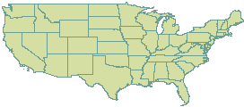
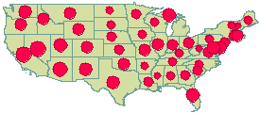
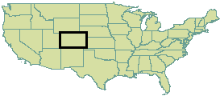
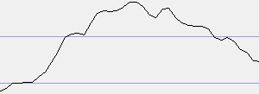
Decomposing a complex behaviour: slices
Space as a whole
Slice: spatial behaviour at this time, usually called spatial distribution
1)
Selected time
t_{k}
Selected place
Slice: temporal behaviour in this place, often called temporal variation
s_{j}
2)
Time as a whole

Slide 24
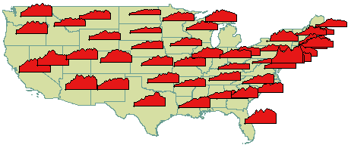
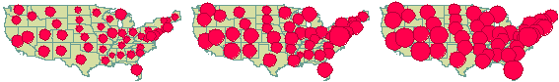
Decomposing a complex behaviour: perspectives
Space as a whole
+
Time as a whole
Spatio-temporal behaviour
Perspective 1:
Spatial distribution of the temporal variations
Perspective 2:
Temporal variation of the spatial distribution
…
t1
t2
t3

Slide 25
Two complementary views of spatial time series
As a spatially distributed set of local temporal variations consisting of time series of attribute values in different locations
As temporally varying spatial situations: sequence of spatial distributions of attribute values at different times
…
t1
t2
t3
These views require different visualisation and analysis techniques.

Slide 26
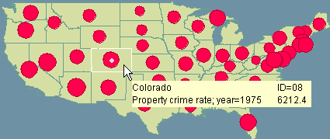
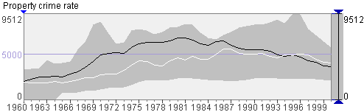
Visualisation of local temporal variations
Limitations of a diagram map:
Not applicable to long time series.
Not applicable when spatial locations are numerous (not enough space for diagrams).
Even when spatial locations are relatively few but irregularly distributed, diagrams in dense areas may overlap.
Complementary displays linked through interactive operations:
Limitation: no overall view of all time series and their spatial distribution.

Slide 27
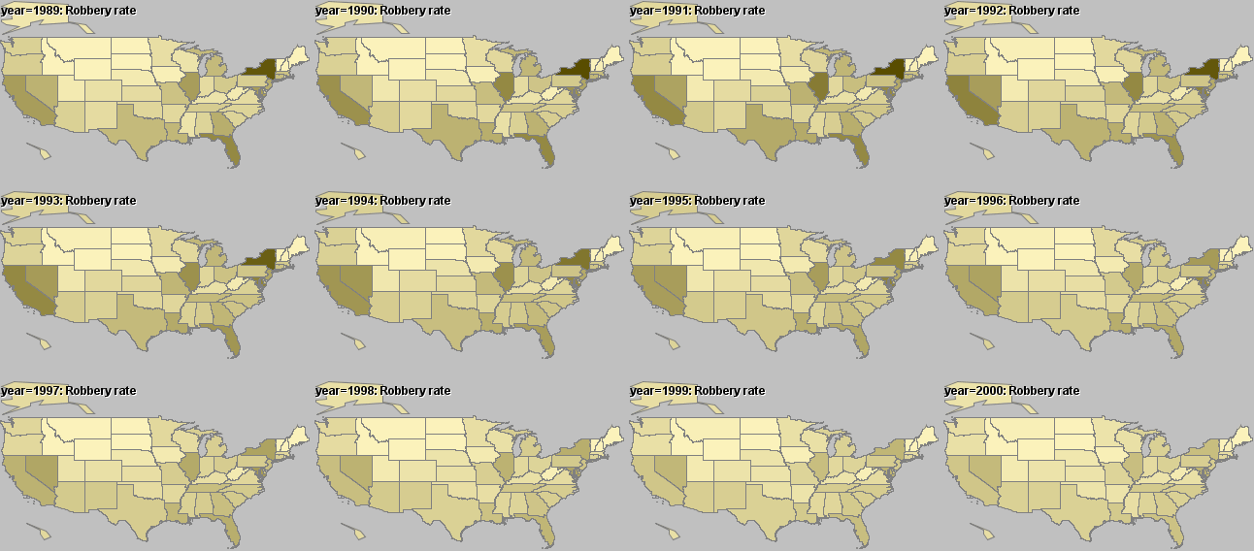
Visualisation of spatial situations by “small multiples”
Limitations:
Applicable to a small number of different time references (time steps)
Hardly applicable to more than one attributes

Slide 28
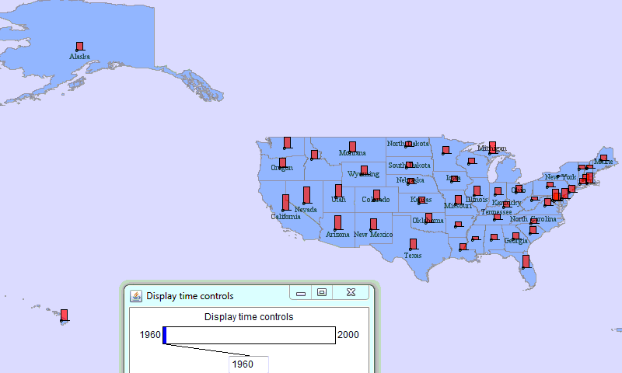
Visualisation of spatial situations by map animation
Limitations:
Keeping previous states in the memory is hard
It is therefore hard to compare states and detect changes

Slide 29
Use of partition-based clustering in analysis of spatial time series
Clustering of the local temporal variations → clusters of places:
Clustering of the spatial distributions → clusters of time steps:

Slide 30
Analysis of spatial time series
A summary
Spatial time series have 2 referrers: space (set of locations) and time (set of time steps – moments or intervals).
The function represented by the data has complex behaviour (dependence on two variables).
To study the complex behaviour, we take two complementary perspectives:
Spatial distribution of local temporal variations
Temporal variation of spatial distributions
Partition-based clustering (PBC) is helpful in studying both aspects
Apply PBC to the set of the local temporal variations, then investigate the spatial distribution of the cluster membership.
Apply PBC to the set of the spatial distributions (values associated with different locations at the same time step), then investigate the temporal distribution of the cluster membership.

Slide 31
Transformations of spatio-temporal data

Slide 32

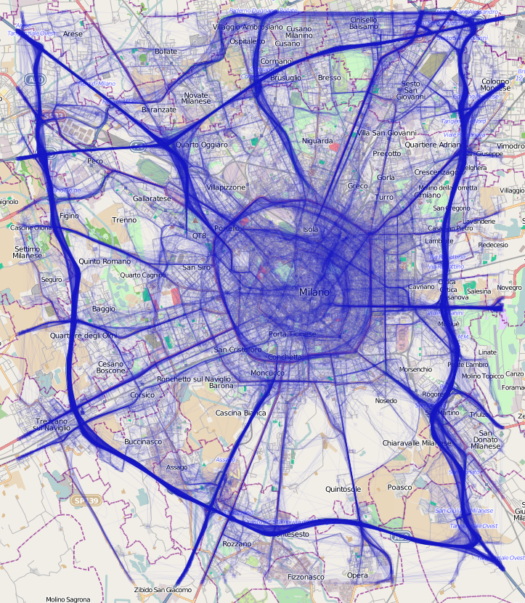
A running example: trajectories of cars in Milan
GPS-tracks of 17,241 cars in Milan, Italy
Time period: April 01-07, 2007 (Sunday to Saturday)
Received from Octo Telematics www.octotelematics.com special thanks to Tina Martino
Data structure:
Anonymised car identifier
Date and time
Geographic coordinates
Speed
The trajectories from one day are drawn on a map with 5% opacity

Slide 33
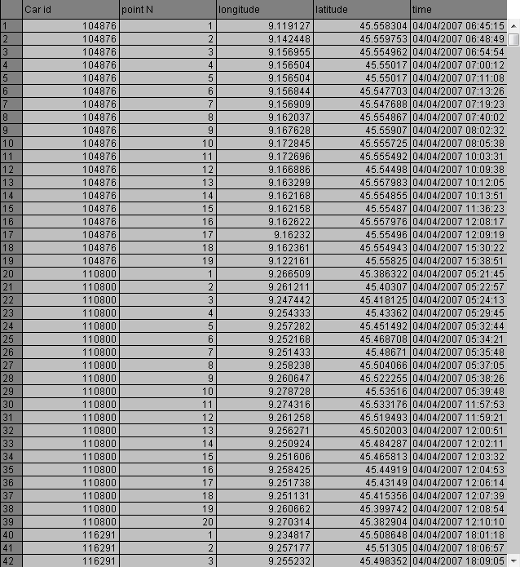
Trajectories
time
Space-time cube

Slide 34
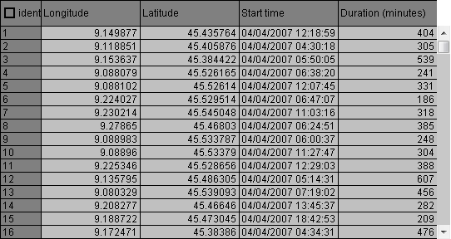
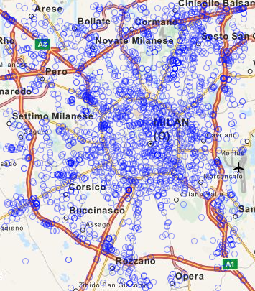
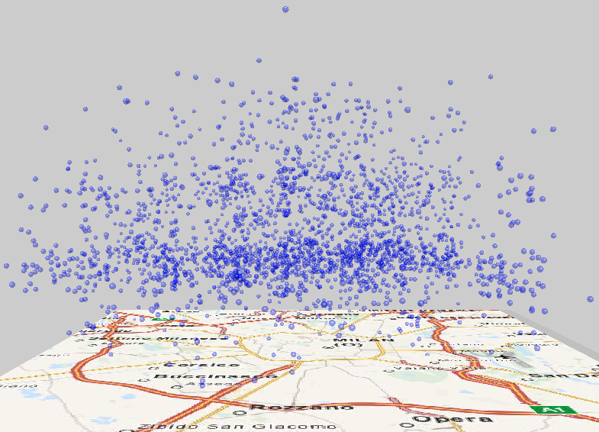
Spatial events
Example: car stops
time
Space-time cube

Slide 35
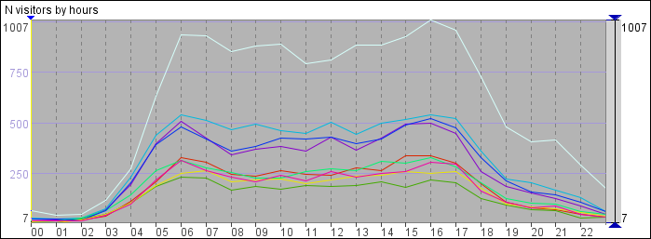
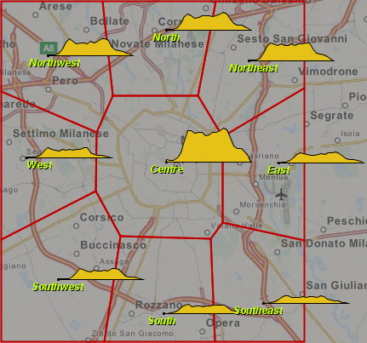
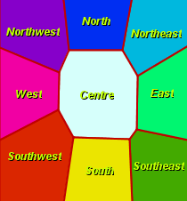
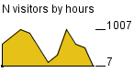
Spatial time series
Example: number of cars that visited regions of Milan in different hours of a day
Time graph
Map with time diagrams
Each line represents the temporal variation of the attribute values in one place

Slide 36
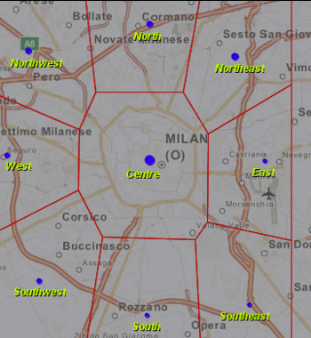
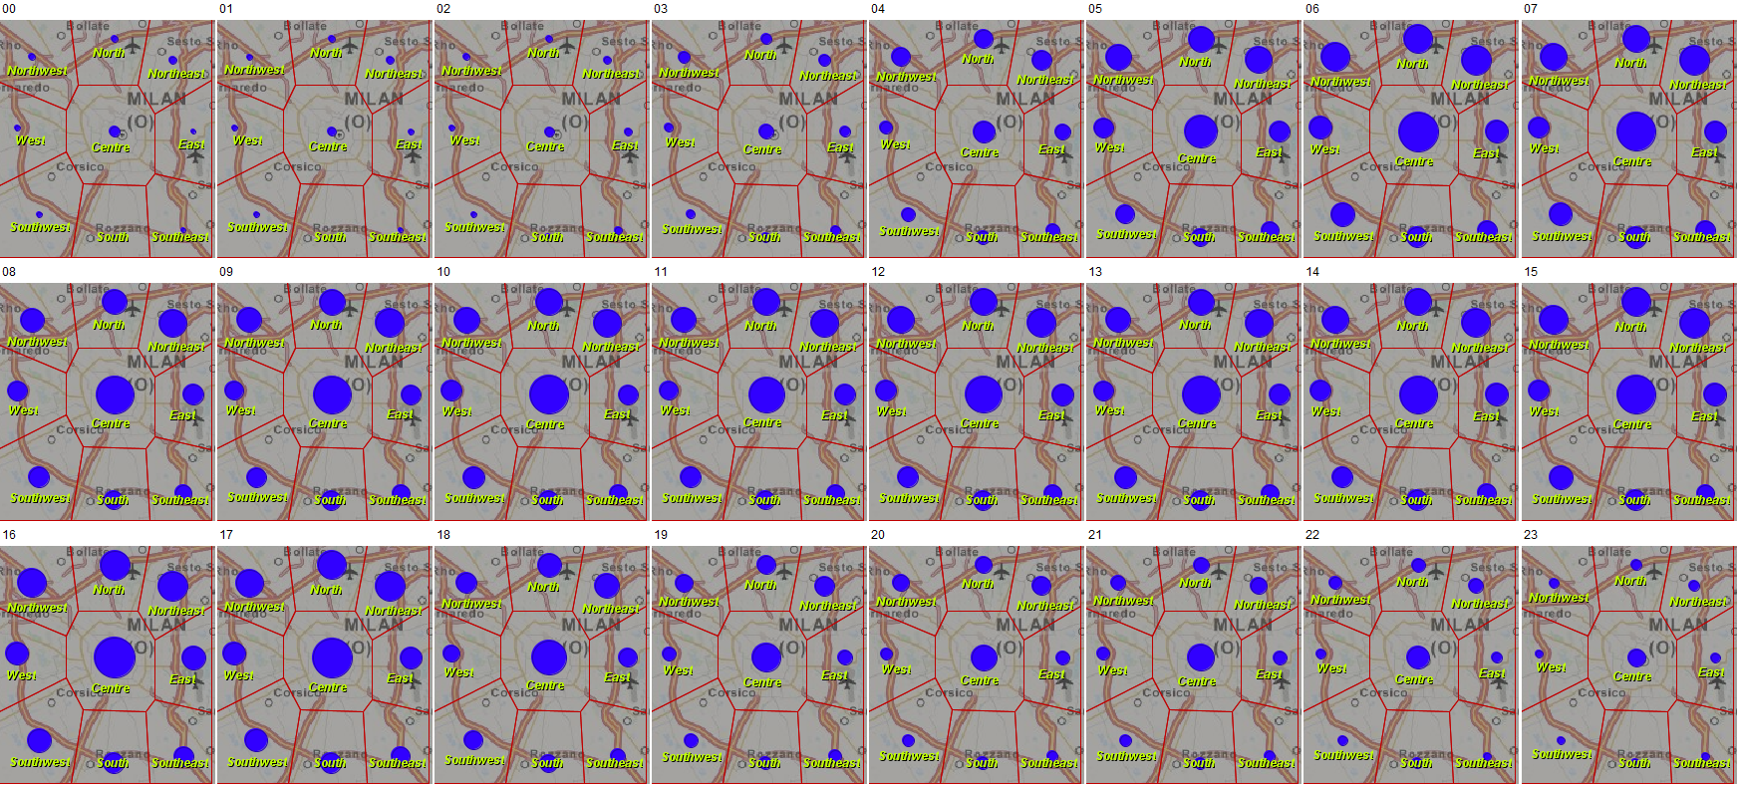
Spatial time series
viewed as a temporal sequence of spatial situations
Numbers of cars in the regions in different hours are represented by proportional sizes of the circle symbols. A sequence of spatial situations may be visualised using an animated map (right) or multiple maps each showing one time moment or interval (below).

Slide 37
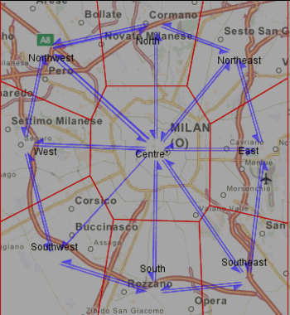
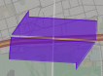
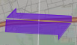
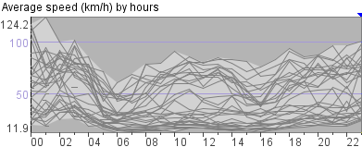
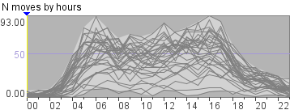
Flows
Link (short for ‘spatial link’)::= a spatial object representing directed relation, such as movement, between 2 locations.
A link is specified by a pair (origin place, destination place).
Links may have attributes such as number of moving objects, number of transitions, movement speed, ...
Links with attributes describing collective movements are called flows.
Flows may be represented on a map by half-arrow symbols with widths proportional to numeric attribute values.
Spatial time series of flows::= attribute values of the links in different time moments or intervals:
((origin, destination), time) → object count, transition count, speed, ...
equal flows in two opposite directions
unequal flows in two opposite directions

Slide 38


The flow symbols
Arrow: shows the movement direction; the width can represent a numeric attribute, such as the number of moving objects or the count of moves.
Problem: it is hard to represent movements in two opposite directions.
Solution: use halves of arrows!
Movement to the right
Movement to the left
Easy to put together:
Can show asymmetric amounts of movement

Slide 39
Alternative shapes of flow symbols

Slide 40
Transformations of spatio-temporal data
Spatial events
integrate
aggregate
extract
Local time series
disintegrate, extract
Spatial time series (place-based)
Trajectories
perspectives (views)
aggregate
Spatial time series (link-based)
Spatial situations
divide

Slide 41
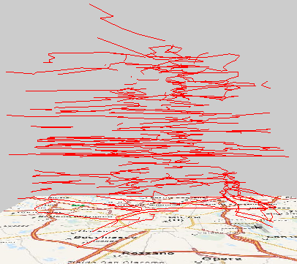
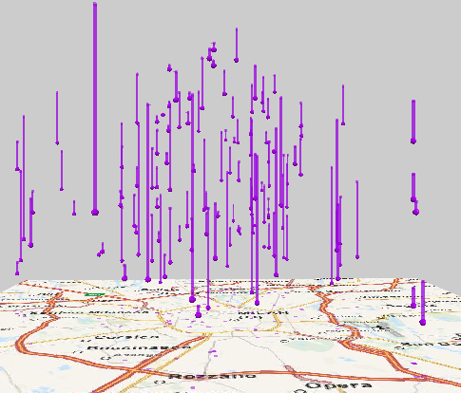
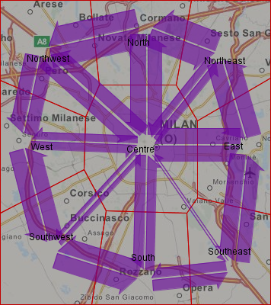
Transformations illustrated
Trajectories
divide into trips
aggregate
extract events
aggregate
presence of cars in areas by time intervals
flows (aggregate moves) of cars between areas by time intervals
e.g., stops and parking

Slide 42
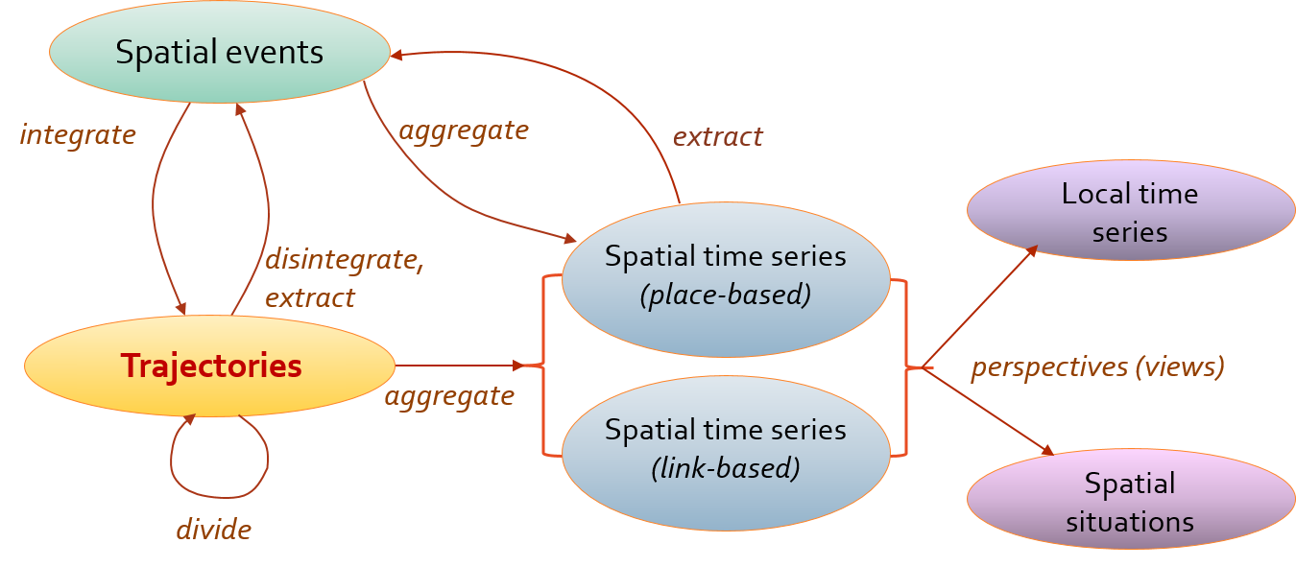
Purposes of data transformations
Aggregation
Supports abstraction, gaining an overall view of characteristics and behaviour
Reduces large data
Simplifies complex data
Extraction of events, etc.
Selects a portion of data relevant to a task, enables focusing
Allows dealing with complex data portion-wise
Integration, disintegration, projection (taking one of possible aspects)
Adapts data to analysis tasks

Slide 43
Spatio-temporal aggregation of spatial events and trajectories

Slide 44
Spatio-temporal aggregation
Divide the space into compartments
Divide the time range of the data into intervals
For each compartment and interval, compute statistics of the events or trajectories (count, density, statistics of attribute values)
In case of trajectories: for each pair of compartments and time interval, compute the number of moves, the number of distinct objects that moved, and statistics of the movement characteristics (e.g., mean speed)
Result: spatial time series

Slide 45
Space division: a regular grid

Slide 46
Space division: arbitrary areas (such as administrative units)
Arbitrary areas may significantly differ in sizes, which distorts the perception of the object density. ⇒ Choropleth maps, like this one, should not be used for representing counts by areas.

Slide 47
Aggregation: absolute counts transformed to relative
A correct image of the variation of the object density can be obtained by transforming the absolute event counts to relative w.r.t. the areas of the districts. When the data are related to lives and activities of people (e.g., tweets), it can also make sense to compute the relative counts w.r.t. the population of the districts.

Slide 48
Space division: an irregular grid

Slide 49
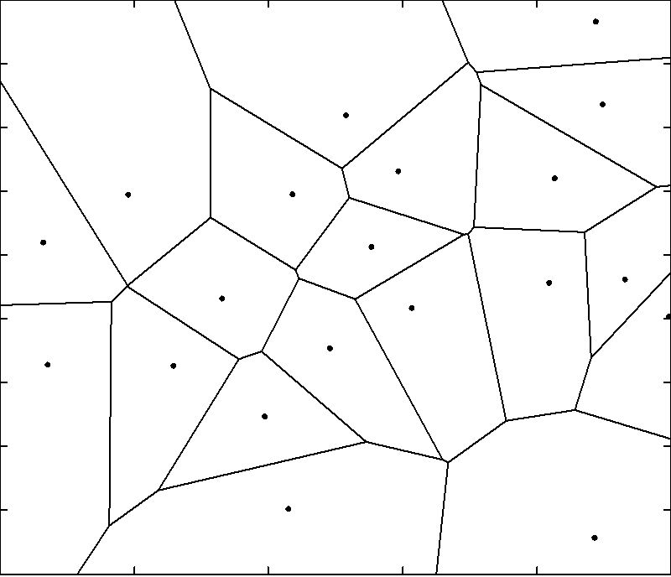
Voronoi tessellation (a.k.a. Voronoi diagram)
Used for building irregular grids
The partitioning of a plane with N points into convex polygons (cells), such that
each polygon contains exactly one generating point
every point in a given polygon is closer to its generating point than to any other.
The generating points are also called seeds.
A Voronoi diagram is also known as a Dirichlet tessellation.
The cells are called Dirichlet regions, Thiessen polytopes, or Voronoi polygons.

Slide 50
Data-driven tessellation

Slide 51
Data-driven tessellation
Step 1: apply a special algorithm for grouping of points based on their spatial proximity.
The main idea: put the points into circles with a given maximal radius R. In this example, R = 2000 m.
Step 2: use the centres of the point groups as generating seeds for the Voronoi tessellation.

Slide 52
Data-driven tessellation

Slide 53
Spatio-temporal aggregation of events

Slide 54
Representation of time cycles
Mosaic diagrams represent values from different time steps by colours of rectangular cells. The cells are arranged in rows the lengths of which equal the length of a time cycle (here: 24 hours of a day).

Slide 55
Transformation of time series (e.g., absolute counts transformed to normalized differences from the means)

Slide 56
The normalized time series are represented by mosaic diagrams.

Slide 57
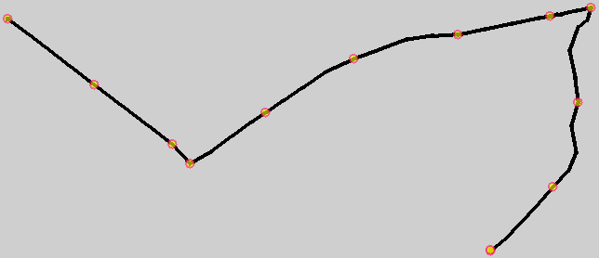
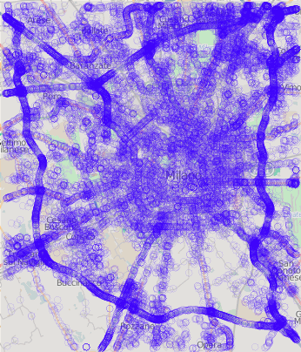
Spatio-temporal aggregation of trajectories: how to divide the territory?
3
1
4
4
4
4
4
4
4
3
4
2
Extract characteristic points from the trajectories: trip starts (1), trip ends (2), points of significant turns (3), points of significant stops, and representative points from long straight segments (4).

Slide 58
Data-driven tessellation based on characteristic points from trajectories

Slide 59
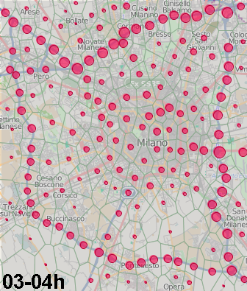



Spatio-temporal aggregates: presence
…
…
This example: hourly counts of cars in the compartments (cells of an irregular grid produced by means of Voronoi tessellation).

Slide 60

Aggregation into flows
Divide each trajectory into segments that link cells.
For each pair of cells, aggregate the linking segments from all trajectories.

Slide 61





Spatio-temporal aggregates: flows

Slide 62
Different levels of spatial abstraction
The parameter R allows choosing a suitable level of spatial abstraction, depending on how much detail is needed.

Slide 63
By spatio-temporal aggregation, we obtain spatial time series, which need to be considered from two perspectives: as spatially distributed local time series and as temporally varying spatial situations.
We can analyse these time series using two-way partition-based clustering.
Spatial events
integrate
aggregate
extract
Local time series
disintegrate, extract
Spatial time series (place-based)
Trajectories
perspectives (views)
aggregate
Spatial time series (link-based)
Spatial situations
divide

Slide 64
Partition-based clustering of local time series
by example of Milan traffic
Links between cells of an irregular grid have been clustered by the similarity of the time series of the average speed values.
Time matrices (rows: days, columns: hours) show the time series of the average speed values for the clusters.

Slide 65

Partition-based clustering of spatial situations
by example of Milan traffic
Each map summarises the spatial situations from one time cluster. The widths of the flow lines represent the average speeds on the links in the time intervals belonging to the cluster in comparison to the overall average speeds.

Slide 66
Extraction of spatial events from spatial time series and trajectories

Slide 67

Events in time series
Time series of attribute values may contain abrupt changes of the values. Such changes can be treated as events, i.e., objects appearing at some time moment and having limited time of existence.
When time series refer to spatial objects or locations, their events are also located in space, i.e., they are spatial events.
Spatial events of interest, such as peaks, can be extracted from time series (e.g., using computational processing) and explored using visualisations and tools suitable for spatial events.

Slide 68

Extraction of events from time series
An example
Spatial time series: counts of authors of photos published in Flickr by monthly time intervals and spatial compartments in Switzerland.
Events: peaks with minimal amplitude 10; extracted using an algorithm implemented in package R.
The crosses on the time graph mark the detected events. The calendar display (rows: years, columns: months) shows the temporal distribution of the number of the extracted events.

Slide 69



Example
Peaks in time series of mobile phone call counts in mobile network cells over Milan, Italy. In very many places, peaks occur after the end of the working hours on the weekdays.

Slide 70



An area with peaks in unusual times
1st half
2nd half

Slide 71
Trajectories and spatial events
Trajectories are composed of spatial events
Each position record of a trajectory describes an event of a moving object having a specific spatial location at some time
Trajectories are created by integration of such events
Grouped by object references
Ordered by time references
A trajectory can be disintegrated into the component events
Events of interest (relevant to the analysis goal) can be detected in and extracted from trajectories

Slide 72
Examples of events occurring in movement
Stop
Reduced speed
Turn
High acceleration
Take-off / landing of an aircraft
Encounter of two or more moving objects
Stop at a particular place of interest
High heart rate {during jogging}
…
Many kinds of events of potential interest can be defined based on values of dynamic attributes.

Slide 73



Interactive filtering based on attribute values
Only the bar segments representing values from the currently active interval(s) are shown.
The map shows only the points and segments of the trajectories where the values of the dynamic attribute satisfy the filter.
Here we see the points and segments where the speed was not more than 10 km/h.

Slide 74


Event extraction based on the segment filter
The segments satisfying the filter are extracted from the trajectories and treated as spatial events. The extracted events are organized in a new dataset consisting of points and multi-points with time references and attributes.
The map shows the extracted low speed events as an independent map layer. The m-events are represented by red hollow circles.

Slide 75

Main takeaways from the lecture
Types of spatio-temporal data: spatial time series, spatial events, trajectories
Spatial time series: two referrers, complex behaviour, need to decompose, two complementary perspectives:
Set of local time series distributed over space
Spatial situations (= spatial distributions of attribute values) changing over time
Spatio-temporal aggregation of spatial events and movement data produces spatial time series.
Spatial events can be extracted from spatial time series and movement data.
The system of possible transformations of spatio-temporal data

Slide 76

Where to read more:
Springer, September 2013, ISBN 978-3-642-37582-8
Ch.1. Introduction
Ch.2. Conceptual framework
Ch.3. Transformations of movement data
Ch.4. Visual analytics infrastructure
Ch.5. Visual analytics focusing on movers
Ch.6. Visual analytics focusing on spatial events
Ch.7. Visual analytics focusing on space
Ch.8. Visual analytics focusing on time
Ch.9. Discussion and outlook

Slide 77
Example: analysis of spatial time series by means of partition-based clustering
Clustering of local temporal variations and spatial situations

Slide 78
Data: time series of weather attributes (monthly averages of temperature, precipitation, wind, …) for 71 weather stations over Germany.
Length of the time series: 241 time steps (months from January 1991 till January 2011).
Analysis task: study how the values of the weather attributes are distributed over Germany and over time.
The data are too large for purely visual exploration. This is a case for using partition-based clustering.

Slide 79
Subtask 1: study the spatial distribution of the local temporal variations
Distance measure: Manhattan distance

Slide 80
2D time histogram is convenient for exploration of time series involving a repeating time cycle. Here we have the cycle of 12 months of a year.
A histogram is an aggregated representation of multiple time series. The sizes of the symbols in the cells may be proportional to sums, averages, etc.

Slide 81
As usual, we need to perform clustering several times and investigate the impact of the parameter(s).

Slide 82
Clustering can be applied simultaneously to time series of several attributes. In this example: monthly averages of the minimal, mean, and maximal daily temperatures and monthly total precipitation amounts.
Exploration and interpretation of clustering results requires in such cases visual displays of all attributes involved in the analysis.

Slide 83
A summary of our findings
Northwest (green): warm winters, moderately warm summers.
East (blue): colder winters, warmer summers.
West, southwest (dark cyan): warm winters, warm summers (sometimes too warm).
Higher altitudes (dark red): generally colder climate, high precipitation.
West, southeast (light cyan): slightly cooler winters and summers, higher precipitation.
Zugspitze: the coldest place in Germany.

Slide 84
Subtask 2: study the temporal variation of the spatial situations
A spatial situation is the distribution of attribute values over a set of spatial locations.
We would like to simplify the task by putting the spatial situations into groups by similarity. PBC is a helpful means for this.
Input to PBC consists of sequences of attribute values. The nature and meaning of the sequences are irrelevant to the clustering algorithm.
In using PBC for subtask 1, we composed each sequence from attribute values associated with a single location but referring to different times. PBC output: groups of similar locations.
For subtask 2, we can compose sequences from attribute values referring to the same times but to different locations. PBC output: groups of similar times.

Slide 85
Technically speaking
Data with 2 references can be organised in a table where rows correspond to one referential component and columns to the other. PBC can be applied either to rows (as we did before) or to columns. In our example, application of PBC to the columns, which correspond to times, will group the times by similarity of the values in the different locations.

Slide 86

PBC has been applied to the values of three temperature attributes. The output is grouping of the months, which can be explored using a temporal display, such as a calendar view.
The temporal display shows how months with similar spatial situations are distributed over the whole time period.
To see what spatial situations correspond to each time cluster, we use a dynamic link between the calendar display and an animated map. By clicking on the calendar display, we select representatives of the clusters. The map is updated to show the spatial situation for the selected time.

Slide 87
Outlier: extremely warm weather

Slide 88
k=4
k=5
k=6
k=7
The pattern of the temporal variation expectably adheres to the seasonal cycle, with some variations from year to year.
The spatial situations differ mostly quantitatively (higher or lower values) rather than in terms of the spatial arrangement of the values.
To see whether the spatial patterns change, we transform the absolute values of the temperatures into differences from the country’s mean.

Slide 89

Outlier (Zugspitze) hidden

Slide 90
Now we see differences in the spatial distributions.

Slide 91
A summary of our findings (1)
These places are always colder than the rest of the country.
They have been earlier put in the same cluster based on the local time series.

Slide 92
A summary of our findings (2)
Groups of similar spatial distributions and their relationships to the time
milder
milder
warmer
warmer
warmer
warmer
average
average
average
warmer
colder
warmer
colder
warmer
changeable
Usual for winters 1991-1992, 1999-2001, 2003-2008
Winter, early spring, late autumn of some years (irregular)
Usual for late spring and early autumn
Usual for summer, can also be in late spring and early autumn

